Slide 1



INDOOR 3D MODEL RECONSTRUCTION TO SUPPORT
DISASTER MANAGEMENT IN LARGE BUILDINGS
Project Abbreviated Title: SIMs3D (Smart Indoor Models in 3D)
PhD Research Proposal
Shayan Nikoohemat
2015-2016
Promoter: Prof. Dr. Ir. George Vosselman
Supervisor: Michael Peter

Slide 2
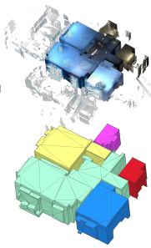
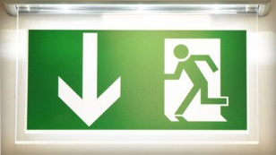
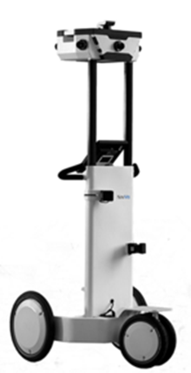
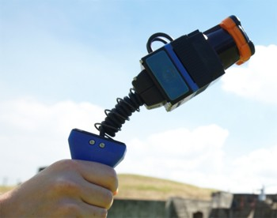
Smart Indoor Models in 3D (SIMs3D)
SIMs3D Project Goals
Indoor 3D reconstruction from point clouds
Emergency responses in public buildings
Data:
Mobile Laser Scanner (MLS) point cloud
Terrestrial Laser Scanner (TLS)
Images
Microsoft Kinect
Ikehata et al. 2015
Point clouds
3D model
NavVis M3 Trolley (www.navvis.com)
Zebedee handheld laser scanner (www.csiro.au)

Slide 3
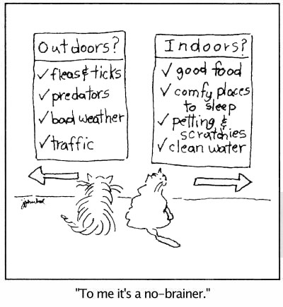
Related Work
3D reconstruction from pointclouds and images
Outdoor:
Building 3D reconstruction
Roof reconstruction
Façade reconstruction
Indoor:
Indoor 3D reconstruction
Scene understanding
Opening detection
Indoor routing
www.cartoonstock.com

Slide 4
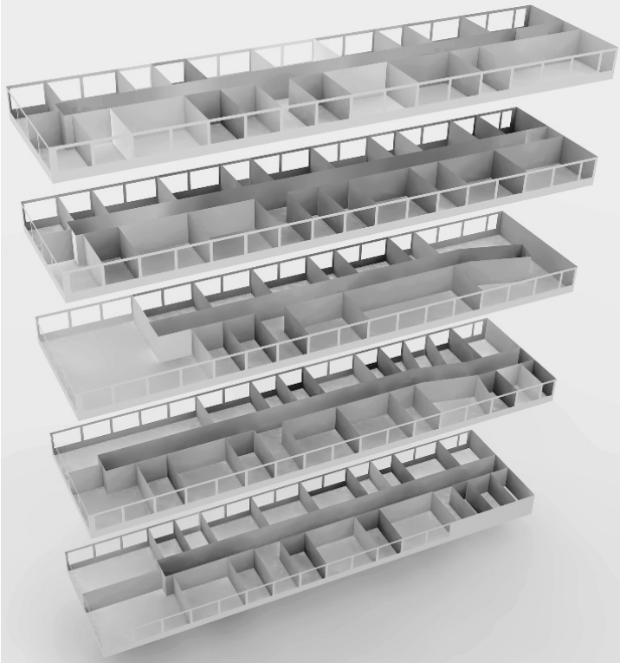
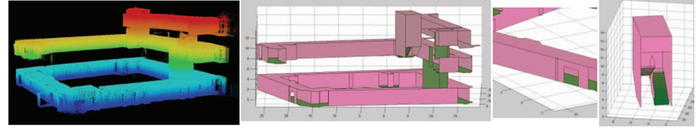
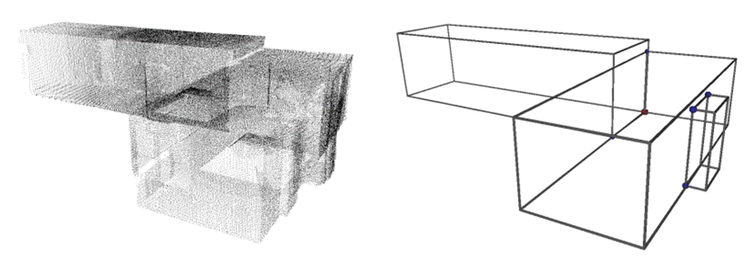
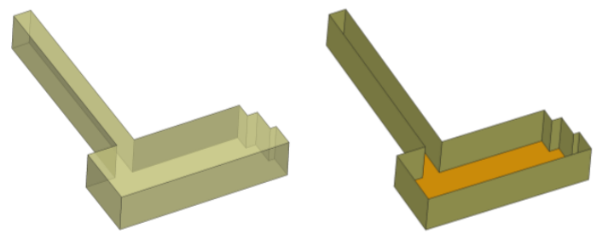
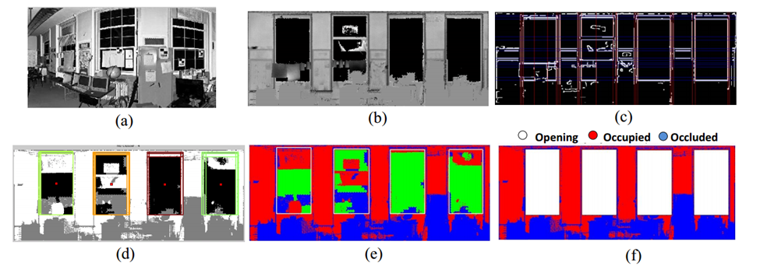
Related Work
Indoor 3D reconstruction methods
1. Planar-based reconstruction (Okorn et al 2010; Sanchez and Zakhor 2012)
2. Volumetric-based reconstruction (Jenke et al 2009; Xiao and Furukawa 2014)
3. Shape grammar (Khoshelham and Diaz-Vilarino 2014; Becker et al 2015)
4. Sporadic works:
Scene understanding (Rusu et al 2009)
Opening detection (Adan and Huber 2011)
Indoor navigation (Zlatanova 2013)
Indoor modeling (Liu and Zlatanova 2012)
Sanchez and Zakhor (2012)
Jenke et al (2009)
Adan and Huber (2011)
Khoshelham and Diaz-Vilarino (2014)
Becker et al (2015)

Slide 5
Motivation and Problem Statement
Indoor 3D models have applications in disaster management, facility management and indoor routing
Tedious work is demanded to generate a precise indoor 3D model from 2D plans
2D plans are not up-to-date or not available for old buildings
Indoor data acquisition is rapid via mobile laser scanners, Microsoft Kinect and GoogleTango
Current indoor 3D models are simple, not scalable and data has no clutter (e.g. furniture)
Limited research has been conducted on grammar-based approaches for indoor 3D reconstruction
Limited research has been conducted on quality control of the generated model

Slide 6
Problem Statement
Non-Manhattan World
Level of Details
Dealing with clutter
Non-Manhattan World
Level of Details
Dealing with clutter
Geometry extraction
Geometry extraction
Applicability
Learning from the data
User interaction
Applicability
Learning from the data
User interaction
Using Grammar for Indoor
Using Grammar for Indoor
Indoor 3D Reconstruction
Indoor 3D Reconstruction
Adding Semantics
Adding Semantics
Using other sources (images, RGBD)
Level of Details
Using other sources (images, RGBD)
Level of Details
Quality Control
Quality Control
Consistency control and accuracy control
Control against IndoorGML standards
Consistency control and accuracy control
Control against IndoorGML standards

Slide 7
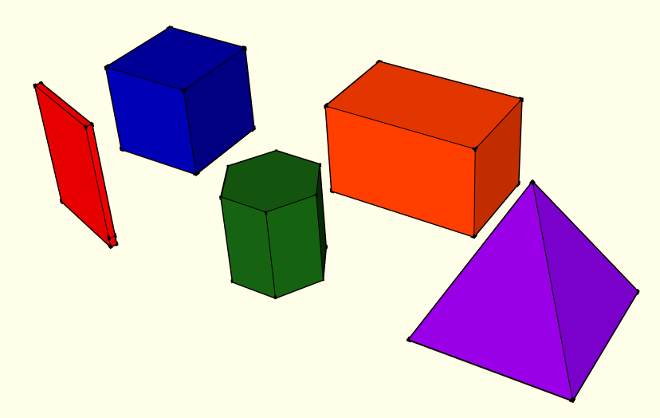
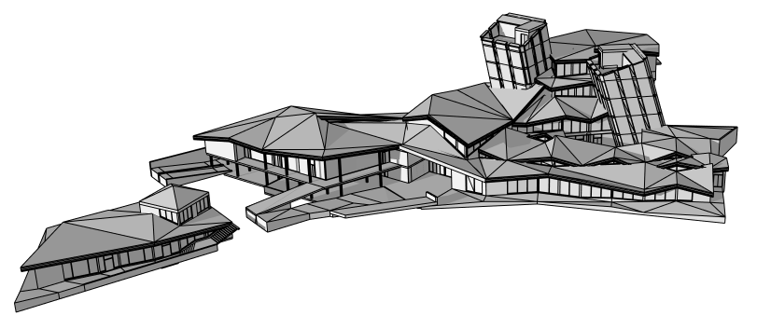
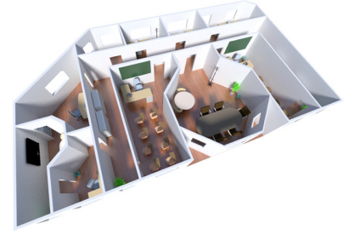
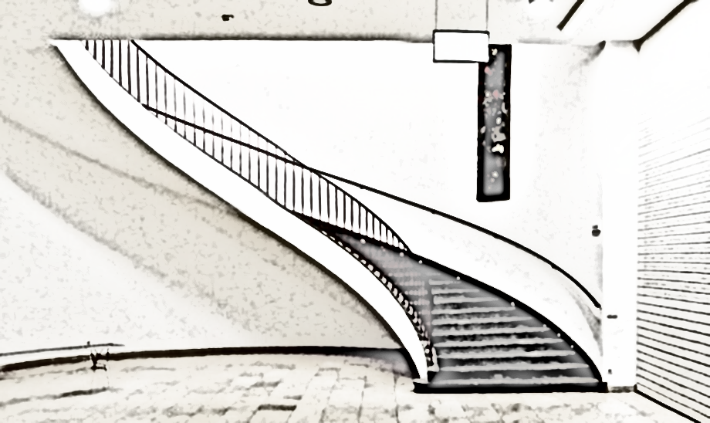
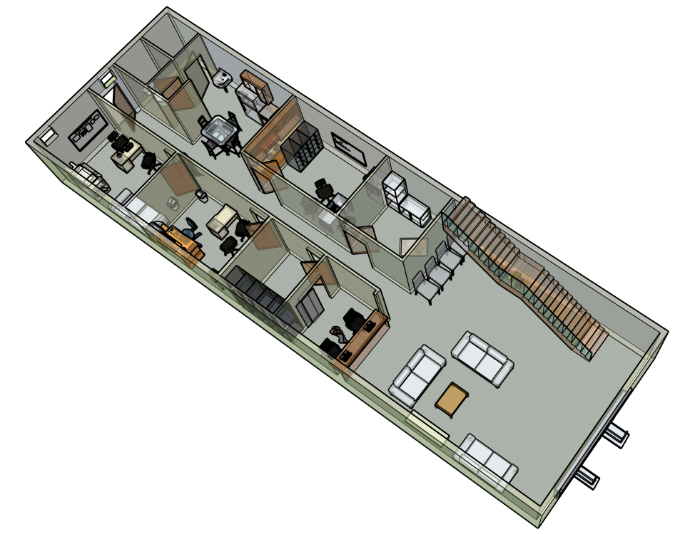
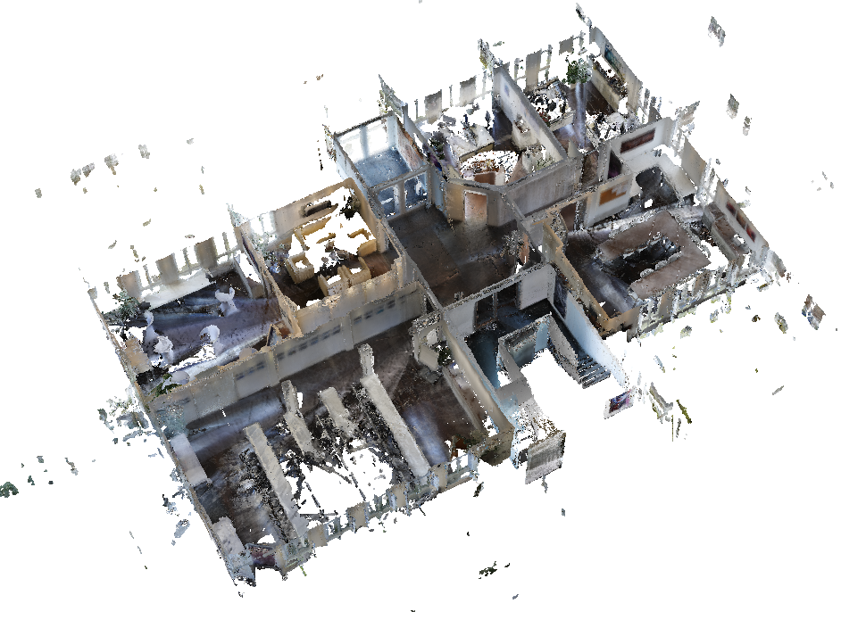
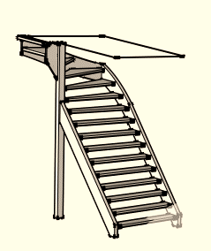
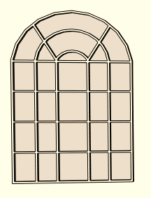
Problem Statement
a. Geometry primitives and solids
c. Non-Manhattan World
e. Level of details
f. Regularity and
repetitiveness
b. Cluttered data
d. Complex shapes

Slide 8

Objectives
Indoor 3D reconstruction objectives
Geometry reconstruction
Designing the grammar
Semantic labeling
Consistency and accuracy control

Slide 9
First Objective
Geometry Reconstruction
Reconstructing non-Manhattan World structure
Extracting geometry details from the point clouds
Dealing with clutter and occlusion
Clutter and occlusion
Non-Manhattan World

Slide 10
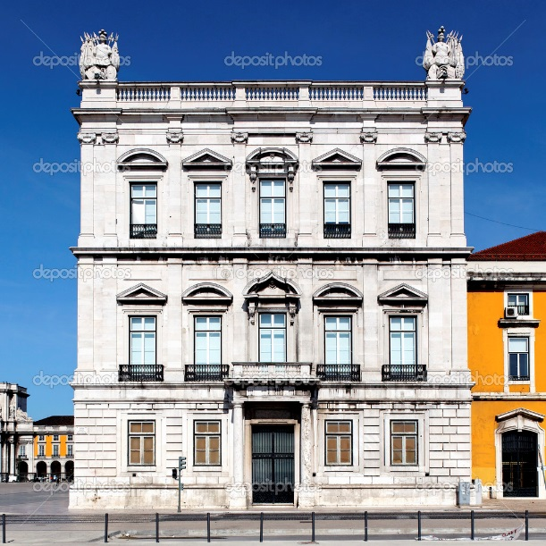
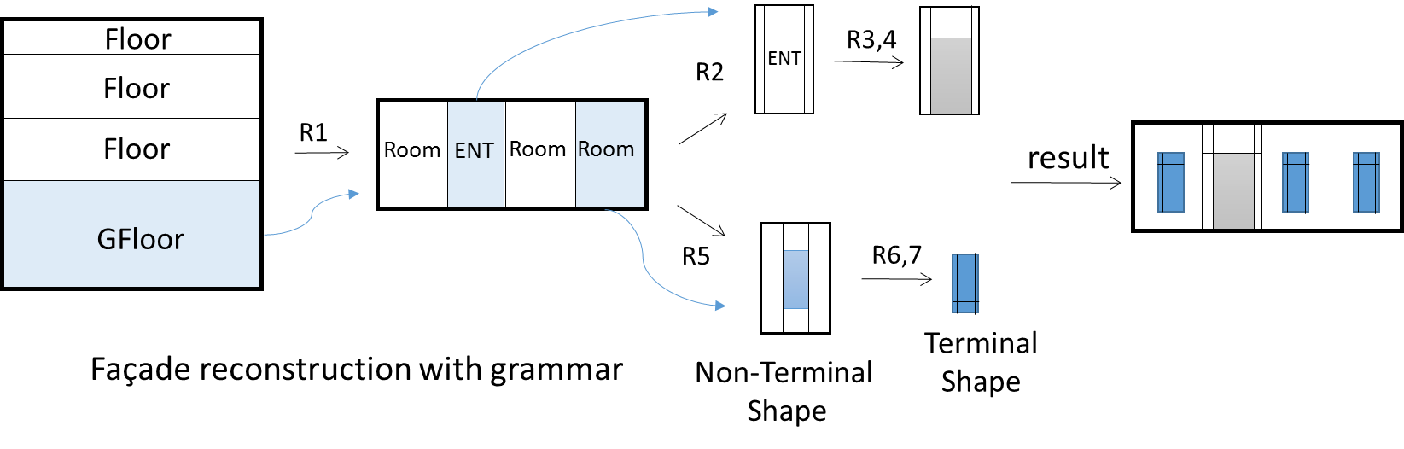
Second Objective
What is Grammar?
Grammar has four components:
1. A finite set of shapes (terminal and non-terminal); e.g. cuboid, door, window
2. A finite set of rules (fixed rules + rules adapted from data); e.g. split, repeat
3. A finite set of shape operations; e.g. merge, clone, scale
4. A finite set of attributes; e.g. semantics, color

Slide 11

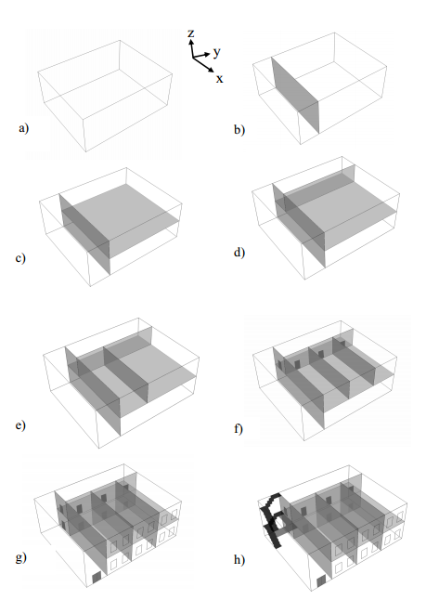
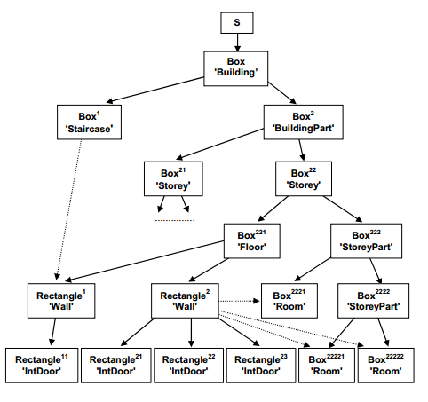
Grammar examples:
Gröger and Plümer (2010)

Slide 12
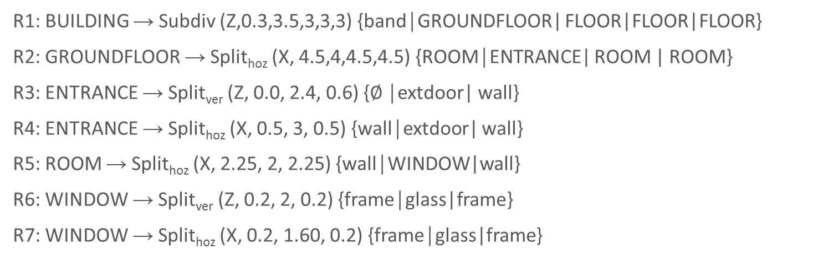
Second Objective
Designing the Grammar
Applicability of grammar for indoor 3D reconstruction
Learning the grammar components from the data
User interaction for active learning of the rules

Slide 13
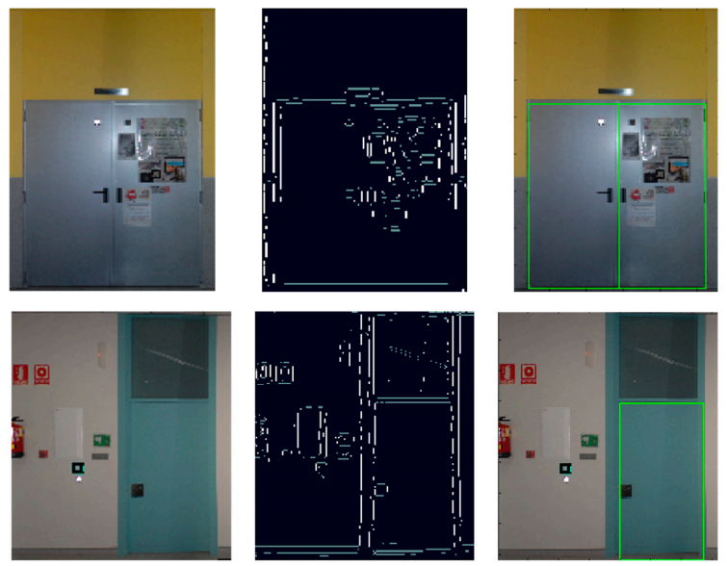
Third Objective
Semantic Labeling
1. Using images for more semantic (opening detection)
2. Adding more details to the coarse 3D model
(navigable, non-navigable areas)
Closed door detection from images
Diaz Vilarino et al. (2015)
Level of Details

Slide 14
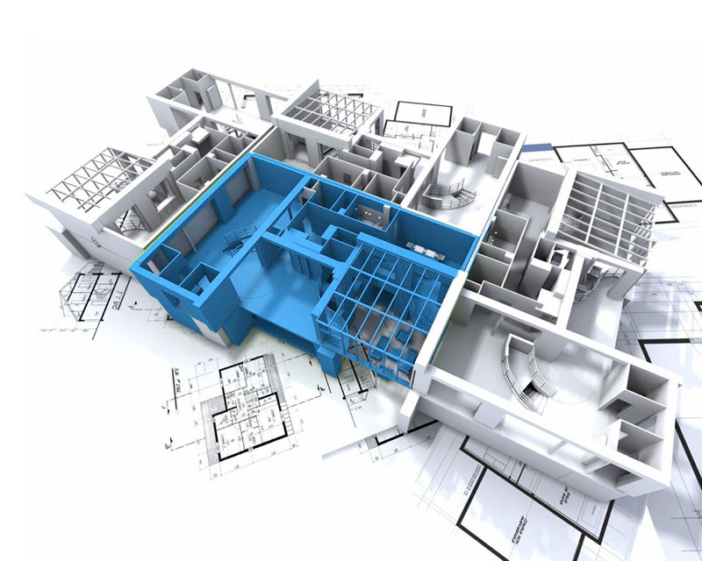

Fourth Objective
Control the consistency and accuracy of the result
1. Consistency control through grammar
2. Accuracy and consistency control against IndoorGML
and Industry Foundation Classes (IFC) standards

Slide 15
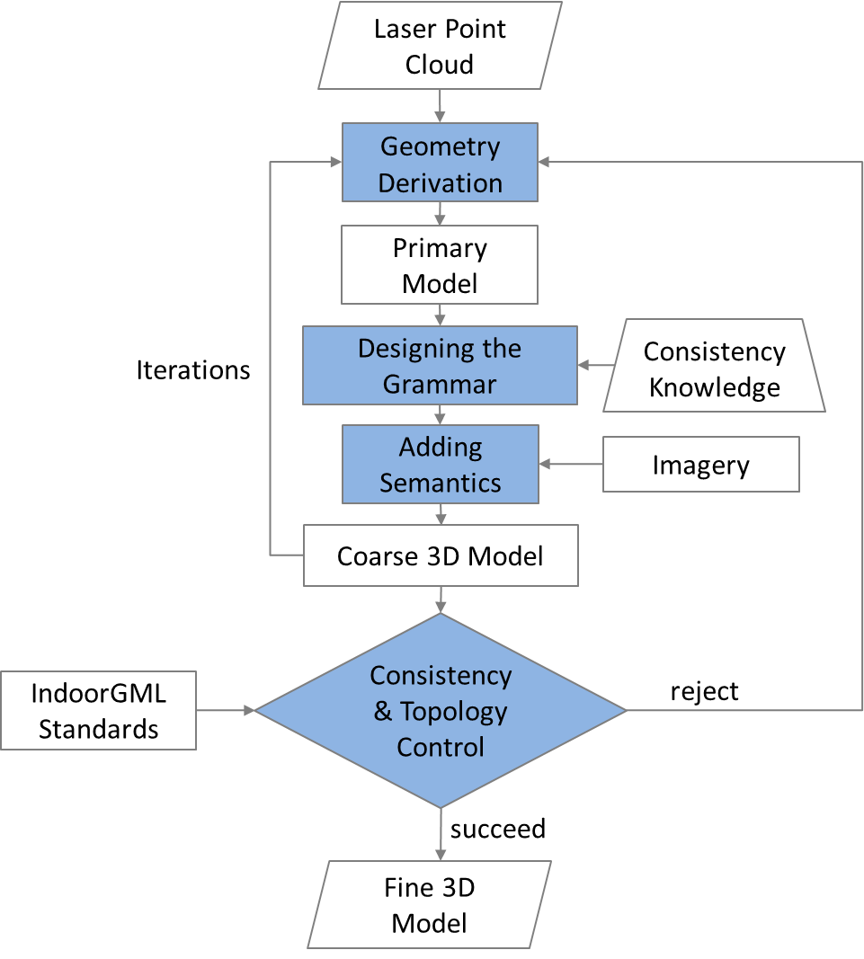
Methodology
An iterative coarse-to-fine methodology
Geometry Derivation
Designing the Grammar
Adding Semantics
Quality Control

Slide 16
Time Schedule

Slide 17
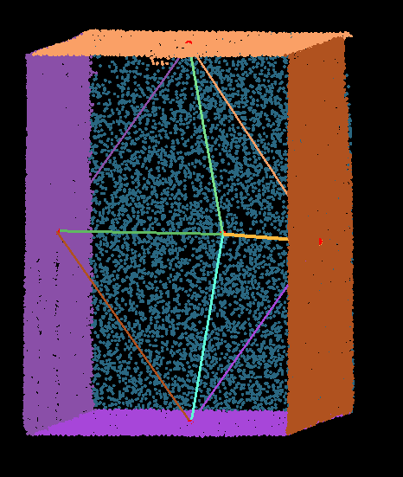
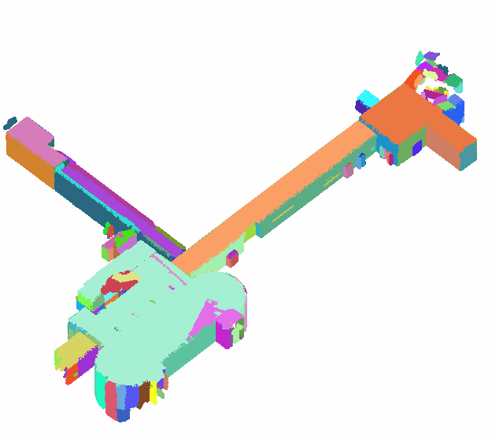
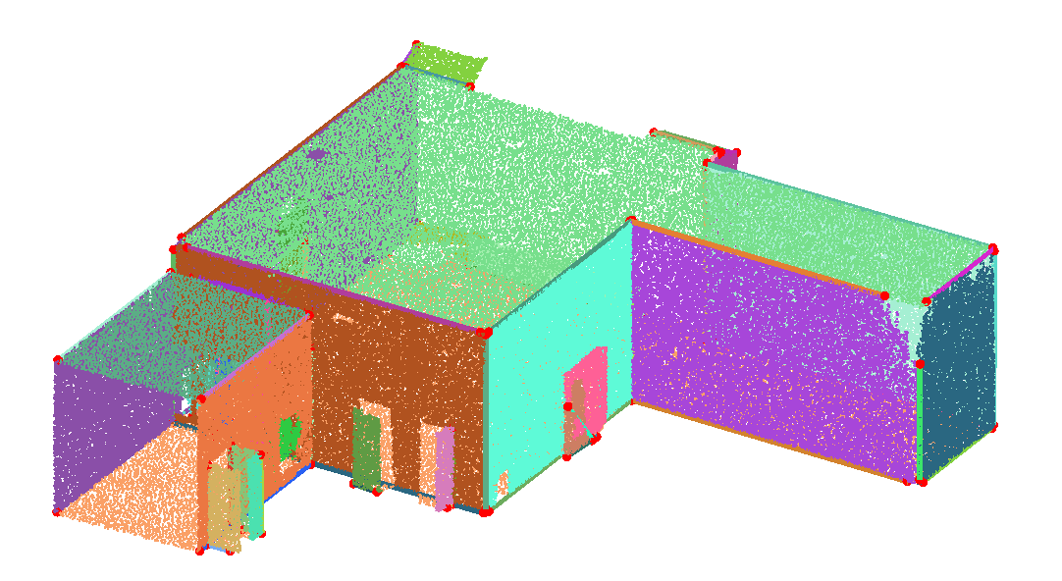
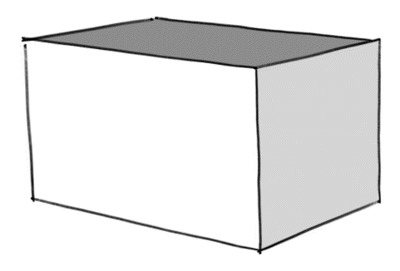
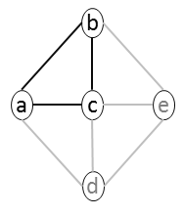
Work in Progress
This work is a development of “indoor data graph” by Oude Elberink, S.J., (2015).
The data accuracy is 3-5 cm and the subsampled data contains 1.5 million points.
Primitive Extraction
b
a
c
Primitive
Reconstruction
Segmentation
Plane Topology Graph
The data is captured by NavVis M3 Trolley from Technical University of Munich’s campus.
Minimum Cycle
Graph
Link to the web viewer

Slide 18
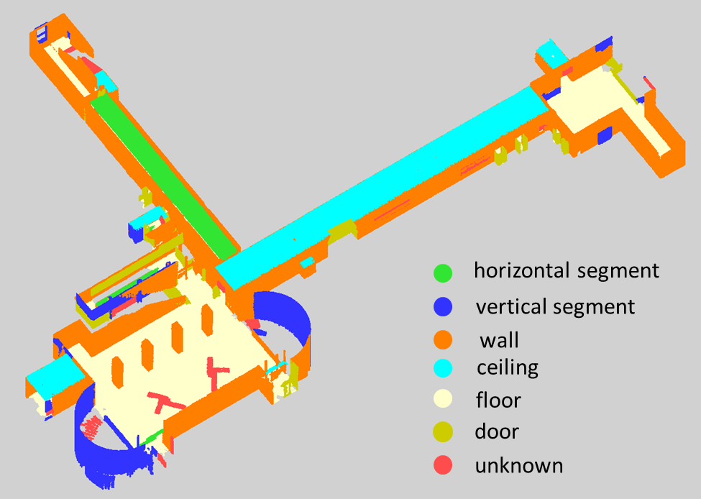
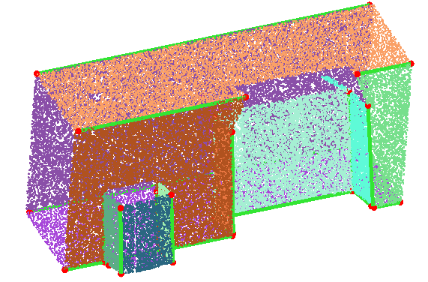
Work in Progress
Intersection problems
Segments labeling

Slide 19

Thank You for your Attention
Questions?
Shayan Nikoohemat
s.nikoohemat@utwente.nl

Slide 20
References
1. Adan, A., Huber, D., 2011. 3D Reconstruction of Interior Wall Surfaces under Occlusion and Clutter, in: 2011 International Conference on 3D Imaging, Modeling, Processing, Visualization and Transmission (3DIMPVT). Presented at the 2011 International Conference on 3D Imaging, Modeling, Processing, Visualization and Transmission (3DIMPVT), pp. 275–281. doi:10.1109/3DIMPVT.2011.42
2. Becker, S., Peter, M., Fritsch, D., 2015. GRAMMAR-SUPPORTED 3D INDOOR RECONSTRUCTION FROM POINT CLOUDS FOR “AS-BUILT” BIM. ISPRS Ann. Photogramm. Remote Sens. Spat. Inf. Sci. 1, 17–24
3. Diaz-Vilarino, L., Khoshelham, K., Martínez-Sánchez, J., Arias, P., 2015. 3D Modeling of Building Indoor Spaces and Closed Doors from Imagery and Point Clouds. Sensors 15, 3491–3512. doi:10.3390/s150203491
4. Jenke, P., Huhle, B., Stra\s ser, W., 2009. Statistical reconstruction of indoor scenes.
5. Khoshelham, K., Diaz-Vilarino, L., 2014. 3D Modeling of Interior Spaces: Learning the Language of Indoor Architecture, in: Proceedings of the ISPRS Technical Commission V Symposium, Riva Del Garda, Italy.
6. Okorn, B., Xiong, X., Akinci, B., Huber, D., 2010. Toward automated modeling of floor plans, in: Proceedings of the Symposium on 3D Data Processing, Visualization and Transmission.
7. Sanchez, V., Zakhor, A., 2012. Planar 3D modeling of building interiors from point cloud data, in: 2012 19th IEEE International Conference on Image Processing (ICIP). Presented at the 2012 19th IEEE International Conference on Image Processing (ICIP), pp. 1777–1780. doi:10.1109/ICIP.2012.6467225

Slide 21
Research Questions:
First Objective (Geometry Reconstruction)
- What are the best solutions for detection of (repeated) shapes in the data?
- What level of details can be extracted from the point clouds?
- How to deal with clutter for an accurate geometry derivation?
- Which approaches are appropriate for non-Manhattan World structure?
Second Objective (Designing the Grammar)
- Is grammar applicable for indoor 3D reconstruction?
- What is the most optimize grammar template for various kind of building structure?
- What are the best solutions for selection of appropriate rules respect to the data?
- How can we limit the user interaction and improve automatic learning from the data for the grammar?
Third Objective (Semantic Labeling)
- What level of details is required for semantics?
- What are the solutions for opening detection under occlusion and closed doors?
- How can we define and label the obstacles for navigation?
Fourth Objective (Consistency and Accuracy Control)
- How can we secure the correctness of our model regarding the topology rules?
- How can we control semantic consistency and geometry accuracy?
- What are the automatic methods for comparing the result with ground truth?

Slide 22
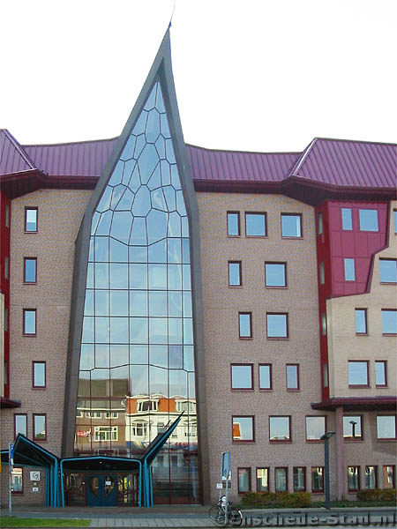
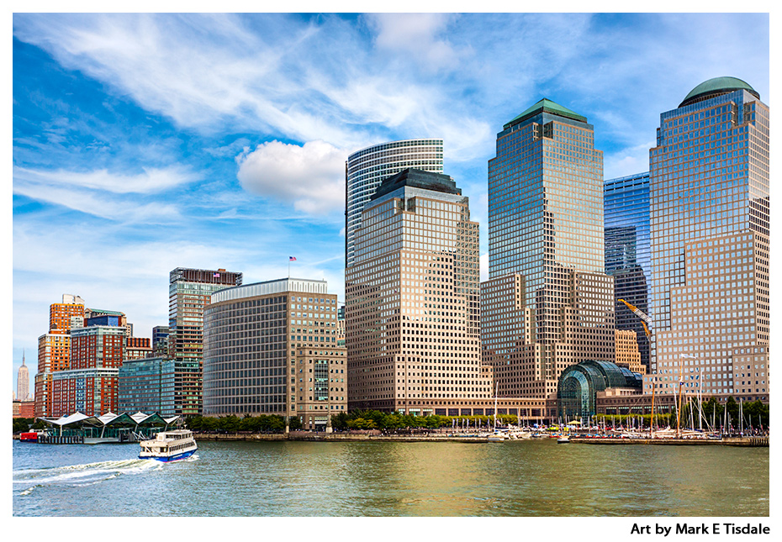
Manhattan World vs non-Manhattan World example:
Manhattan Financial Center
Non-Manhattan World facade

